Slide 1



VERIFEYE: A BROWSER-BASED DIGITAL RADAR FOR ONLINE THREAT AWARENESS

Slide 2







WE ARE TEAM
HOOK HUNTERS
We're a collaborative team HookHunters passionate about cybersecurity, working hands-on together across all parts of VerifEye to build a smarter, safer browsing experience.

Slide 3


WHAT IS VERIFEYE?
VerifEye is a lightweight browser extension that scans websites in real time to detect phishing, malicious scripts, disinformation, and privacy threats. It uses custom-built, offline analysis modules to generate risk scores and alert users instantly — all without relying on third-party APIs, ensuring maximum privacy and full user control.

Slide 4


PROBLEM STATEMENT
With rising threats like phishing, trackers, and disinformation, most users lack effective, real-time protection. Existing tools are often too complex or miss subtle risks, highlighting the need for a lightweight, privacy-focused browser solution that detects and explains threats clearly.
Thousands of harmful websites go live daily, spreading scams and disinformation.
Most users can’t spot a phishing web page.
Traditional spam filters aren’t smart enough..

Slide 5



WHAT MAKES VERIFEYE UNIQUE
Built with pure JavaScript, no frameworks or libraries
100% local scanning – no data ever leaves the browser
7-layer threat detection in one lightweight extension
Smart false positive reduction using context and trusted domains
Real-time risk score with quick user actions
No login, no tracking – privacy-first by design

Slide 6

TECH STACK
JavaScript – Core logic and analysis engine
HTML5 – Structure for popup, dashboard, and settings pages
CSS3 – Styling (themes, animations, responsive UI)
Chrome Extension APIs – Tabs, Runtime, Storage, Scripting, etc.
chrome.storage.local – For storing scan results, user settings, and trusted domains
No Frameworks or Libraries – Fully custom-built, no React/Vue, no external dependencies

Slide 7


HOW IT WORKS
🔍 Page Scanning: When a webpage loads, VerifEye extracts key data — URL, scripts, forms, and content.
🧠 Multi-layered Analysis: Data is analyzed across 7 security modules (e.g., phishing, malicious code, privacy risks).
📊 Risk Scoring: Each module contributes to a final risk score (0–100), determining the threat level.
⚡ User Alerts & Actions: The result is shown in the popup with clear alerts, quick actions, and export options — all processed locally.

Slide 8

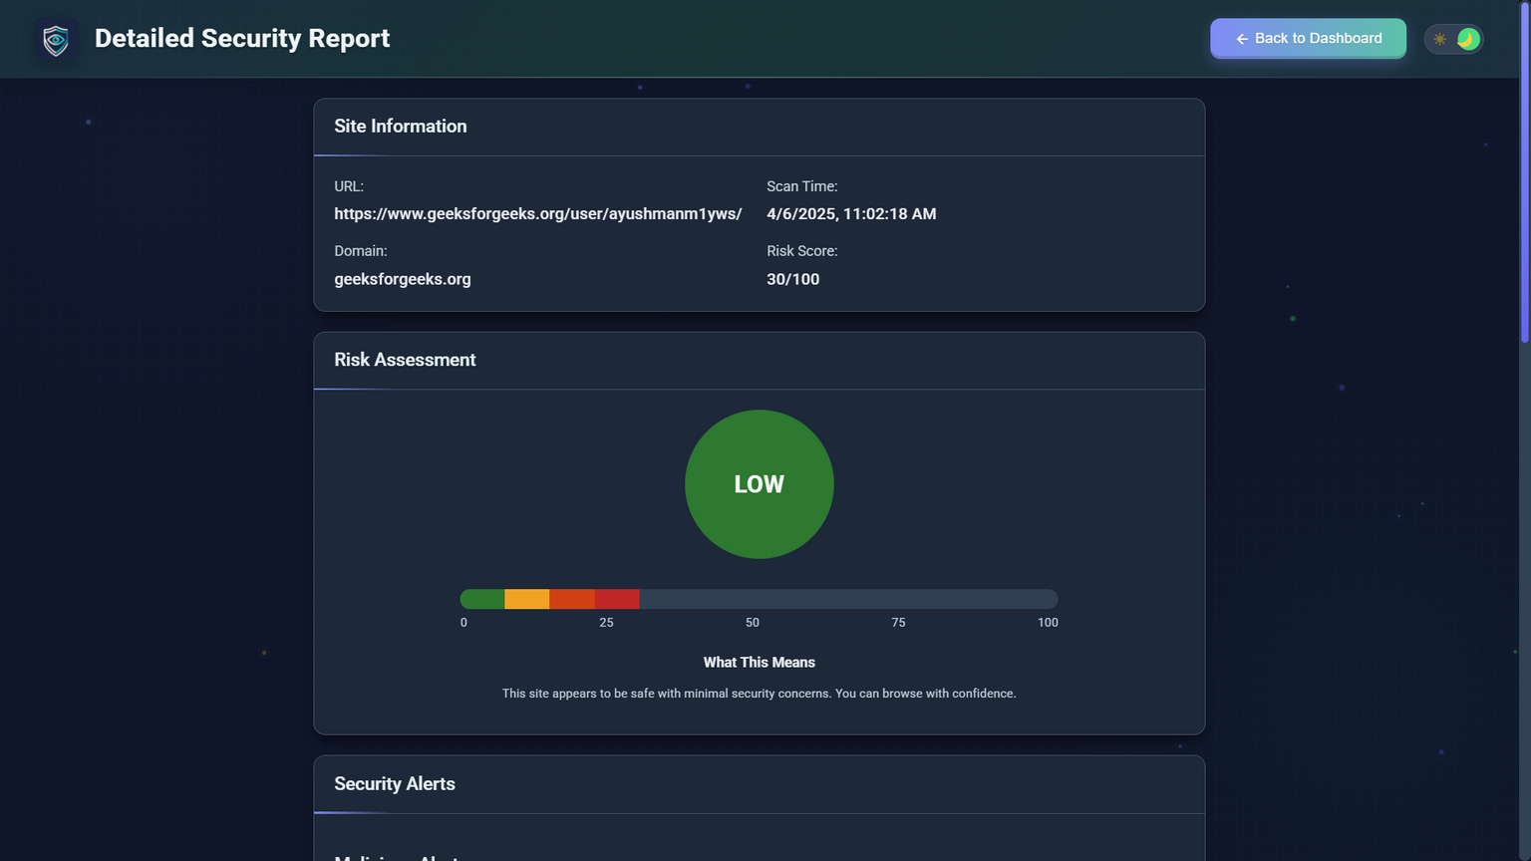
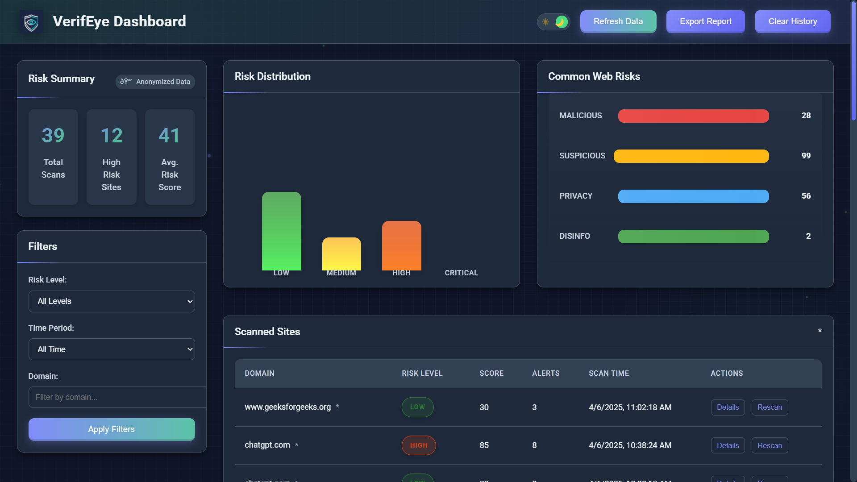
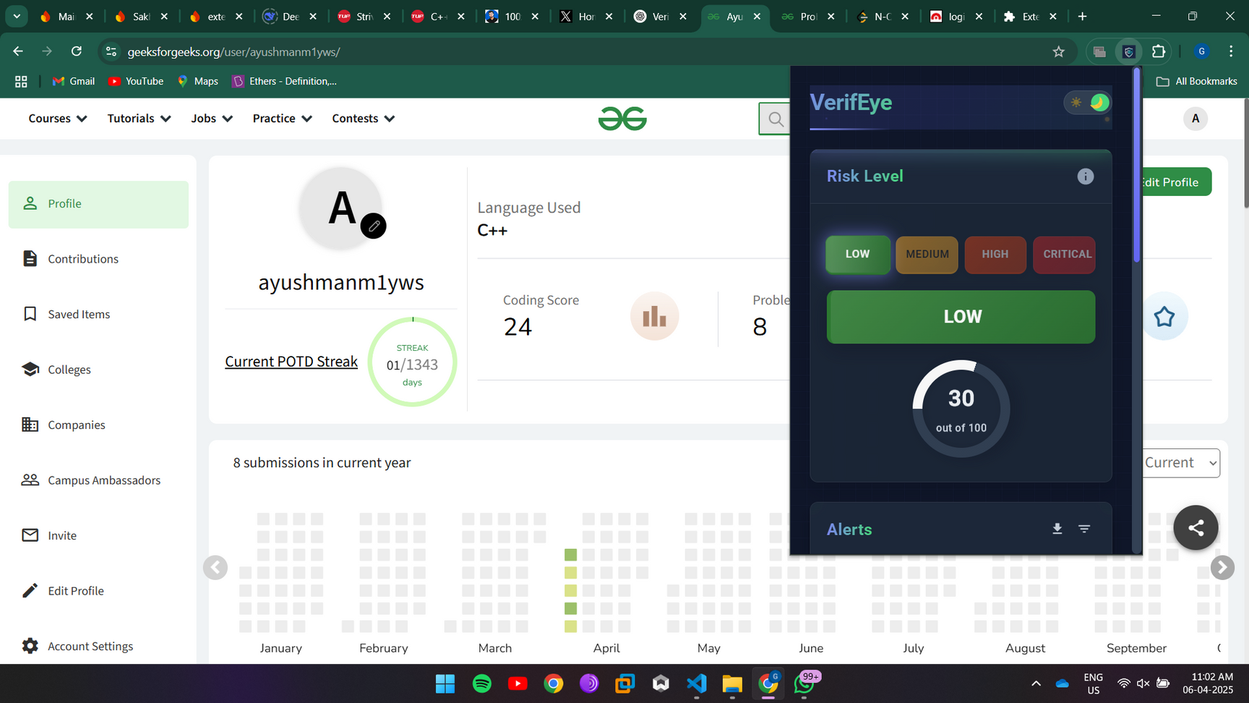
UI PREVIEW / DEMO

Slide 9


FUTURE SCOPE
🧠 AI-powered risk scoring for smarter detection
🌐 Launch on Firefox, Edge, and Brave stores
📱 Mobile browser extension support
📊 Advanced analytics dashboard
🌍 Multi-language localization support

Slide 10
THANK YOU

